Slide 1
Evaluating the Quality and Impact of Community Benefit Programs
September 27, 2016
Julie Trocchio
Senior Director, Community Benefit and Continuing Care
The Catholic Health Association
Kimberly Peeren
Senior Public Health Consultant
Healthy Communities Institute, a Xerox Company

Slide 2
Learning Objectives
Understand the mission and legal basis for evaluating the quality and impact of community benefit programs.
Learn how the CDC’s Framework for Program Evaluation can be used to evaluate community health improvement activities.
Become familiar with tools and resources for evaluating and reporting the impact of community health improvement programs to help meet new IRS requirements for tax-exempt hospitals.

Slide 3

Resource: CHA Evaluation Guide
Source: https://www.chausa.org/communitybenefit/community-benefit

Slide 4

Why Evaluate?
To improve programs
To assess the organization’s impact
To ensure resources are being used wisely
To meet federal requirements

Slide 5
Federal Requirements
Implementation Strategy | Community Health Needs Assessment
Include anticipated impact of activities taken in response to CHNA | Report impact
Source: https://www.federalregister.gov/articles/2014/12/31/2014-30525/additional-requirements-for-charitable-hospitals-community-health-needs-assessments-for-charitable

Slide 6
Community Benefit Cycle
Community Health Needs Assessment
Implementation / Program Planning
Implementation and Evaluation
Community Health Needs Assessment
IDENTIFY
PRIORITIES
DESIGN
EVALUATION
EVALUATE PROGRESS
REPORT EVALUATION FINDINGS

Slide 7
CDC Evaluation Framework
PLAN
Engage stakeholders
Describe the program
Focus evaluation design
IMPLEMENT
4. Gather credible evidence
ANALYZE AND USE FINDINGS
5. Justify conclusions
6. Ensure use and share lessons learned
1. Engage Stakeholders
2. Describe the Program
3. Focus Evaluation Design
4. Gather Credible Evidence
5. Justify Conclusions
6. Ensure Use and Share Lessons Learned
Standards
Utility
Feasibility
Propriety
Accuracy
Source: http://www.cdc.gov/eval/framework/

Slide 8

Resource: CDC Guide
Source: http://www.cdc.gov/eval/guide/index.htm

Slide 9
CDC Evaluation Framework
PLAN
Engage stakeholders
Describe the program
Focus evaluation design
IMPLEMENT
4. Gather credible evidence
ANALYZE AND USE FINDINGS
5. Justify conclusions
6. Ensure use and share lessons learned
1. Engage Stakeholders
2. Describe the Program
3. Focus Evaluation Design
4. Gather Credible Evidence
5. Justify Conclusions
6. Ensure Use and Share Lessons Learned
Standards
Utility
Feasibility
Propriety
Accuracy
Source: http://www.cdc.gov/eval/framework/

Slide 10
Step 1. Engage Stakeholders
Who is involved in program operations?
Who is served?
Who will use findings?

Slide 11

Resource: HPOE Guide
Source: http://www.hpoe.org/resources/hpoehretaha-guides/2846

Slide 12
Who Will Use the Findings?
Decision-makers
Program planners
Individuals reporting to regulators
Senior staff
Board members
Funders

Slide 13
CDC Evaluation Framework
PLAN
Engage stakeholders
Describe the program
Focus evaluation design
IMPLEMENT
4. Gather credible evidence
ANALYZE AND USE FINDINGS
5. Justify conclusions
6. Ensure use and share lessons learned
1. Engage Stakeholders
2. Describe the Program
3. Focus Evaluation Design
4. Gather Credible Evidence
5. Justify Conclusions
6. Ensure Use and Share Lessons Learned
Standards
Utility
Feasibility
Propriety
Accuracy
Source: http://www.cdc.gov/eval/framework/

Slide 14
Step 2. Describe the Program
Goal
Resources to be used
Activities
Anticipated outcomes

Slide 15
Program Mapping
Inputs
Outputs
Outcomes
Resources
What we invest in our programs
Activities + Participants
What we do and whom we reach through our programs
Results
What happens as a result of our programs

Slide 16

Simple Logic Model
Family & friends
Prepare and pack
Learn about nature; develop backpacking skills; increase bonding among family and friends!
Budget
Drive to destination
Time
Set up camp
Backpacking gear & supplies
Backpack & explore
INPUTS
OUTPUTS
OUTCOMES

Slide 17
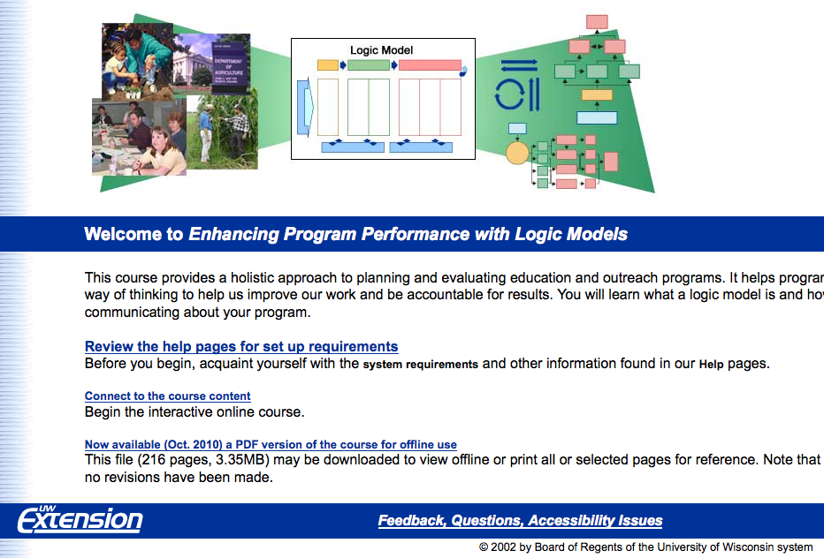
Resource: UWEX Logic Models
Source: http://www.uwex.edu/ces/lmcourse/

Slide 18
CDC Evaluation Framework
PLAN
Engage stakeholders
Describe the program
Focus evaluation design
IMPLEMENT
4. Gather credible evidence
ANALYZE AND USE FINDINGS
5. Justify conclusions
6. Ensure use and share lessons learned
1. Engage Stakeholders
2. Describe the Program
3. Focus Evaluation Design
4. Gather Credible Evidence
5. Justify Conclusions
6. Ensure Use and Share Lessons Learned
Standards
Utility
Feasibility
Propriety
Accuracy
Source: http://www.cdc.gov/eval/framework/

Slide 19
Step 3. Focus Evaluation Design
Determine evaluation purpose
  Program expansion/replication
  Funding
  Objectives
Identify what program aspects to evaluate
Identify what questions to ask
Identify indicators for evaluation questions
Design the evaluation

Slide 20
Step 3. Focus Evaluation Design
Determine evaluation purpose
Identify what program aspects to evaluate
  Short, medium, long-term outcomes
  Cost effectiveness, etc.
Identify what questions to ask
Identify indicators for evaluation questions
Design the evaluation

Slide 21
Step 3. Focus Evaluation Design
Determine evaluation purpose
Identify what program aspects to evaluate
Identify what questions to ask
Identify indicators for evaluation questions
Design the evaluation

Slide 22
Process Questions
How was the program carried out?
  Who did the program reach?
  How involved were participants in program activities?
  Were activities implemented as planned?
  How satisfied were participants?
  What else happened?

Slide 23
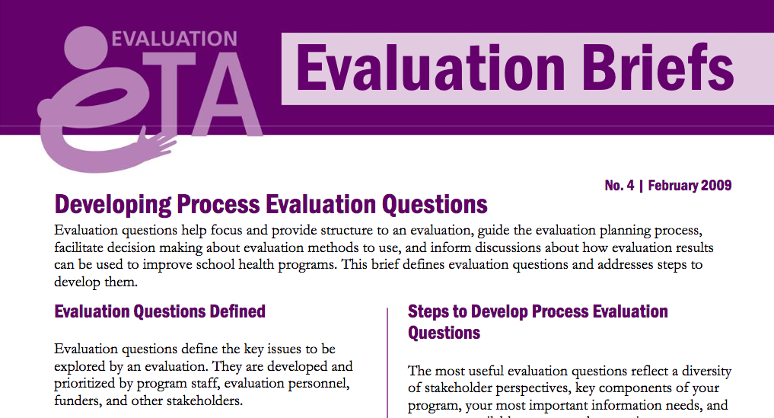
Resource: Evaluation Briefs
Source: http://www.cdc.gov/healthyyouth/evaluation/pdf/brief4.pdf

Slide 24
Impact Questions
What changed?
  Did participants increase their knowledge or awareness?
  Did participants acquire new skills?
  Did participants change their behavior?
  Did health status improve?
  Did program achieve anticipated impact?

Slide 25
Step 3. Focus Evaluation Design
Determine evaluation purpose
Identify what program aspects to evaluate
Identify what questions to ask
Identify indicators for evaluation questions
Design the evaluation

Slide 26
Evaluation Designs
Post-test only
Pre-test and post-test (single group)
Pre-test and post-test with two or more groups
Pre-test and post-test with control group

Slide 27


Post-Test Only
PROGRAM
AFTER
Simple design; many factors can influence results and no other results to compare with

Slide 28
Pre-Test Post-Test (one group)
BEFORE
PROGRAM
AFTER
Can compare pre/post results of one group; must consider factors that can influence participants and results (e.g., participant selection, external events)

Slide 29
More than One Group
BEFORE
AFTER
PROGRAM
BEFORE
AFTER
NO PROGRAM OR DIFFERENT PROGRAM
Can compare different groups’ results; must consider factors that can influence participants, groups and results

Slide 30
Control Group
BEFORE
AFTER
PROGRAM
Groups with
similar
characteristics
BEFORE
AFTER
NO PROGRAM OR DIFFERENT PROGRAM
Can compare results of similar groups receiving different interventions; consider group comparability and other factors that can influence results

Slide 31
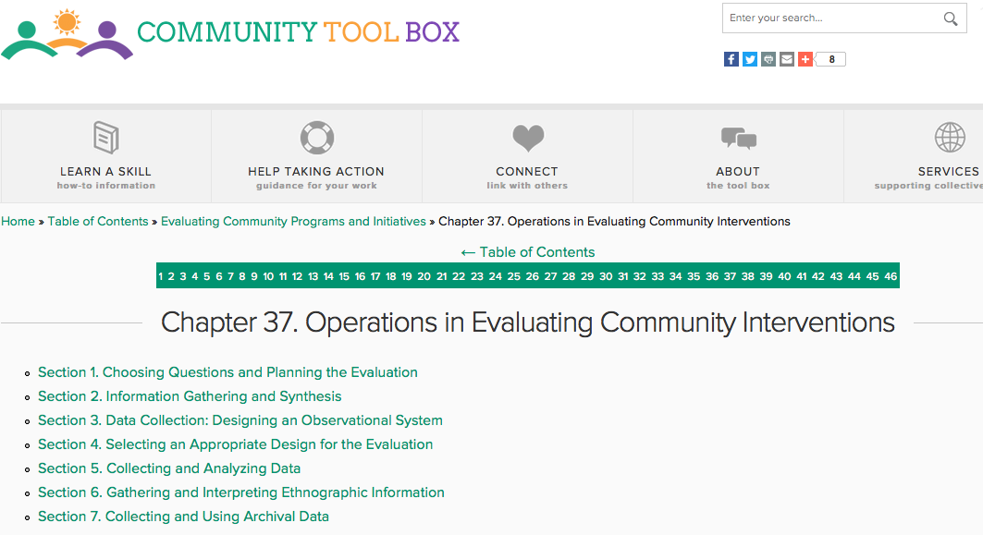
Resource: Community Toolbox
Source: http://ctb.ku.edu/en/table-of-contents/evaluate/evaluate-community-interventions

Slide 32
CDC Evaluation Framework
PLAN
Engage stakeholders
Describe the program
Focus evaluation design
IMPLEMENT
4. Gather credible evidence
ANALYZE AND USE FINDINGS
5. Justify conclusions
6. Ensure use and share lessons learned
1. Engage Stakeholders
2. Describe the Program
3. Focus Evaluation Design
4. Gather Credible Evidence
5. Justify Conclusions
6. Ensure Use and Share Lessons Learned
Source: http://www.cdc.gov/eval/framework/

Slide 33

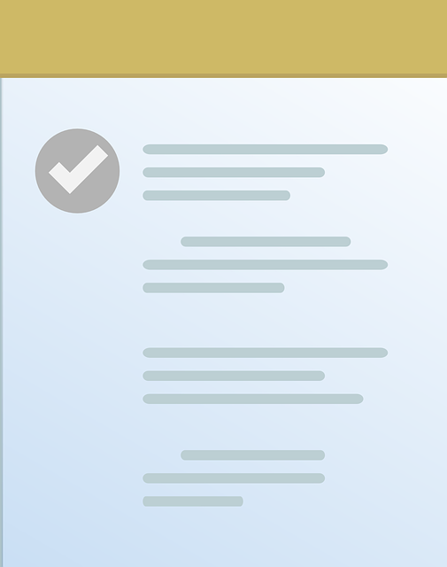
Types of Data
Quantitative data = numbers
  Counts, ratings, scores
  E.g. # of participants, survey scores
Qualitative data = narrative
  Descriptions
  E.g. key informant interviews, observation studies

Slide 34
Types of Data
PRIMARY DATA | SECONDARY DATA
Original data collected for your own purposes | Data collected by someone else
Surveys, questionnaires Focus group discussions Key informant interviews Program records, existing databases Observation | County Health Rankings State and local health departments CMS Small Area Health Insurance Estimates USDA Food Environment Atlas, etc.

Slide 35

Step 4. Gather Credible Evidence
Have a plan for:
  Questions to be answered
  Data sources for answers
  Method of collecting data
  Timing
  Who is responsible

Slide 36
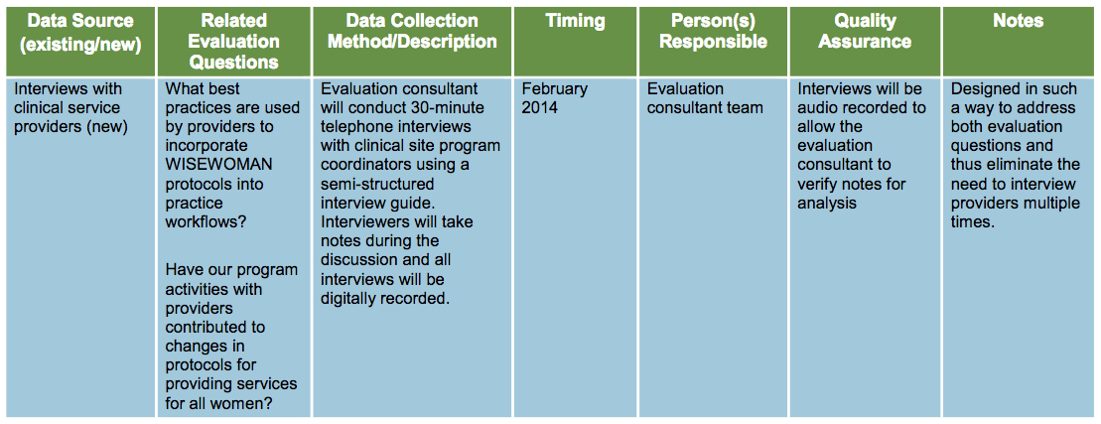
Data Collection Plan
Source: http://www.cdc.gov/wisewoman/evaluation_toolkit.htm

Slide 37

Resource: WISEWOMAN Toolkit
Source: http://www.cdc.gov/wisewoman/evaluation_toolkit.htm

Slide 38
CDC Evaluation Framework
PLAN
Engage stakeholders
Describe the program
Focus evaluation design
IMPLEMENT
4. Gather credible evidence
ANALYZE AND USE FINDINGS
5. Justify conclusions
6. Ensure use and share lessons learned
1. Engage Stakeholders
2. Describe the Program
3. Focus Evaluation Design
4. Gather Credible Evidence
5. Justify Conclusions
6. Ensure Use and Share Lessons Learned
Standards
Utility
Feasibility
Propriety
Accuracy
Source: http://www.cdc.gov/eval/framework/

Slide 39
Step 5. Justify Conclusions
Analyze and interpret results
Examine patterns
Consider factors that may have influenced results (e.g., external events)

Slide 40
Step 5. Justify Conclusions
Process:
  Was the strategy implemented correctly?
  Did any external events intervene?
  If program was evidence-based, was it faithful to the model?

Slide 41
Step 5. Justify Conclusions
Impact:
  Did program participants change?
  Were the changes measurable?
  Were the changes likely because of the program?

Slide 42
Resources: Data Analysis
CDC’s WISEWOMAN Evaluation Toolkit
CDC Evaluation Briefs:
  Analyzing Qualitative Data: http://www.cdc.gov/healthyyouth/evaluation/pdf/brief19.pdf
  Analyzing Quantitative Data: http://www.cdc.gov/healthyyouth/evaluation/pdf/brief20.pdf

Slide 43
Look At Your Evaluation Findings
What does information suggest about program?
Was program carried out as planned?
Any surprising information?
What lessons were learned?
Positive findings? Negative findings?

Slide 44
CDC Evaluation Framework
PLAN
Engage stakeholders
Describe the program
Focus evaluation design
IMPLEMENT
4. Gather credible evidence
ANALYZE AND USE FINDINGS
5. Justify conclusions
6. Ensure use and share lessons learned
1. Engage Stakeholders
2. Describe the Program
3. Focus Evaluation Design
4. Gather Credible Evidence
5. Justify Conclusions
6. Ensure Use and Share Lessons Learned
Standards
Utility
Feasibility
Propriety
Accuracy
Source: http://www.cdc.gov/eval/framework/

Slide 45
Audiences to Share Findings With
Program participants
Program managers, staff
Funders
Hospital leaders
Community members
Policy makers

Slide 46
Federal Requirements
Implementation Strategy | Community Health Needs Assessment
Include anticipated impact of activities taken in response to CHNA | Report impact
Source: https://www.federalregister.gov/articles/2014/12/31/2014-30525/additional-requirements-for-charitable-hospitals-community-health-needs-assessments-for-charitable

Slide 47
Step 6. Ensure Use
Improve program
Identify resources needed
Make decisions about program
Replicate/expand program
Disseminate information to those who might be interested in adopting program

Slide 48
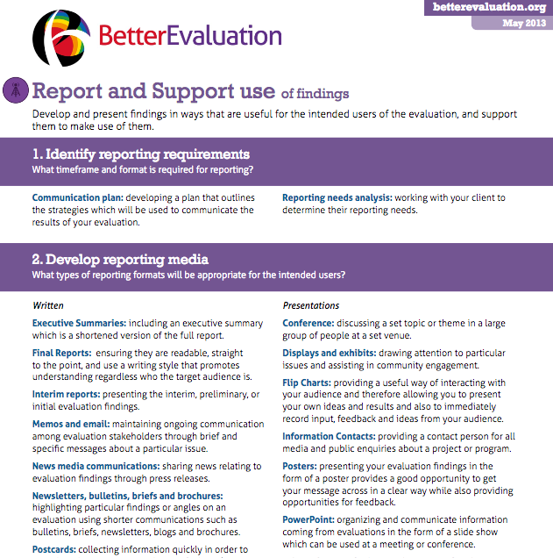
Resource: BetterEvaluation
Source: BetterEvaluation - Report and Support Use of Findings (May 2013) http://betterevaluation.org

Slide 49

Resource: HPOE Guide
Source: http://www.hpoe.org/resources/hpoehretaha-guides/2858

Slide 50
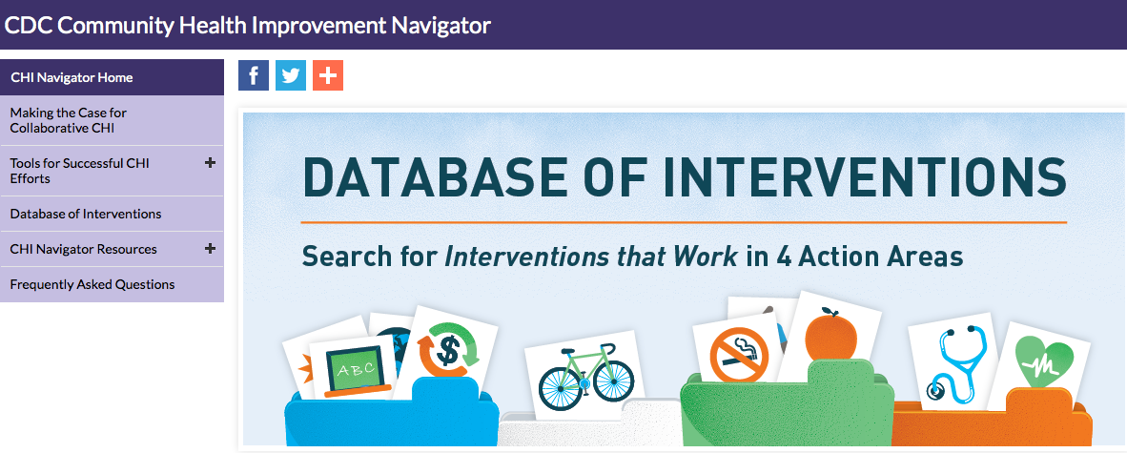
Resource: CDC CHI Navigator
Source: http://www.cdc.gov/chinav/

Slide 51
Resource: CHA Evaluation Guide
Source: https://www.chausa.org/communitybenefit/community-benefit

Slide 52
Questions?
Thanks for participating in this webinar!

